Slide 1
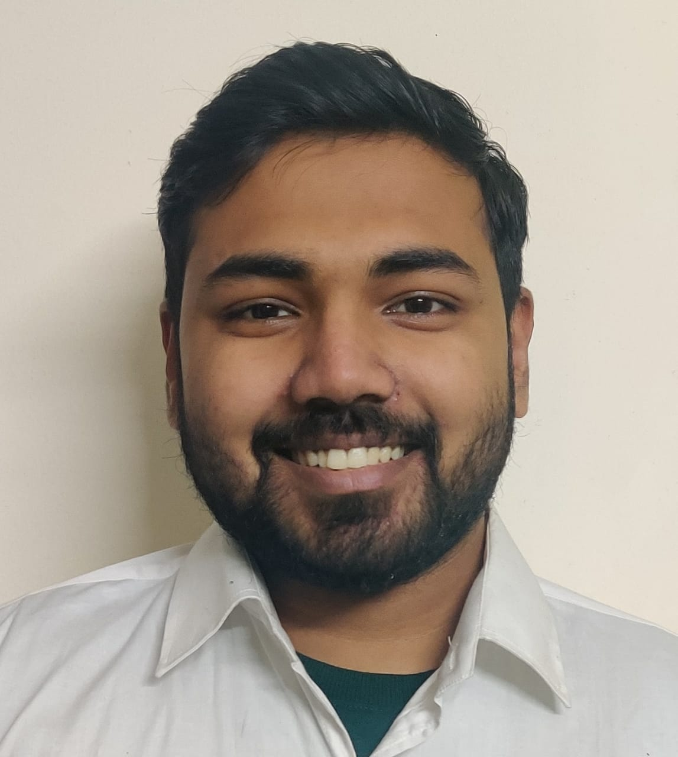


Novel Sai Vinayak Malla
Bachelor of Technology: Mechanical
2018 - 2022
Skills
Full Stack
Java
NodeJS
Database
No SQL database – MongoDB
No SQL database - DynamoDB
Web Technologies
HTML5
CSS3
JavaScript
Express
ES6
Add-Ons
GitHub
Maven
Postman
Swagger
Additional Details
Leadership
Communication Skills
Team management
Analyst/Software Engineer
Chennai PCT
Java
Express
NodeJs
Javascript
MongoDb
AWS lex
AWS cloudfront
AWS lambda
AWS API gateway
AWS dynamoDB
AWS S3
AWS cognito
AWS cloud9
React
Novel.sai-vinayak-malla@capgemini.com
+91 6383835258
A4
Engineer who is Strong in design and integration with intuitive problem-solving skills. Passionate about implementing and launching new projects.
Eager to work in a team of dedicated people and serve a key role in the enhancement and development of the project.
Ready to learn new technologies and implement them to further improve my knowledge.
Has knowledge on ReactJS and Java Microservice Development using Spring framework on an intermediate level.
Has knowledge on NodeJs with expressJs with mocka and chai for testing, and AWS management console with building few serveless application.
E-Commerce Shopping Basket Application
Completed end to end case study of Shopping cart System along with swagger, postman implementation and connection of frontend to backend. React, Bootstrap used for user interface and spring boot used for backend.
AWS fundamentals: Building serveless application
Made a serveless application using AWS services such as lex, cloudfront, S3, api gateway, DynamoDB. Made an interactive bot which returned the temp of the city, with voice activation included.
Building modern node.js application on AWS
Learnt more about cloud9, lambda function policies, cognito, step functions, observability, IAM roles.
Check out me on GitHub & LinkedIn

